Slide 1
Systems Analysis
and
Design
Systems Design
User Interface, Input, Output Design

Slide 2
Phase Description
Systems Design is the third of five phases in the systems development life cycle
We will work on a physical design that will meet the specifications described in the system requirements document
Tasks will include output and user interface design, data design, and system architecture

Slide 3
Introduction
Output and user interface design is the first task in the systems design phase of the SDLC
Output design focuses on user needs for screen and printed forms of output, while user interface design stresses user interaction with the computer, including input design and procedures
Notes:
4

Slide 4
Output Design
Before designing output, ask yourself several questions:
  What is the purpose of the output?
  Who wants the information, why is it needed, and how will it be used?
  What specific information will be included?
  Will the output be printed, viewed on-screen, or both? What type of device will the output go to?
  When will the information be provided, and how often must it be updated?
  Do security or confidentiality issues exist?

Slide 5
Output Design
Types of Output
  Internet-based information delivery
    Webcast
  E-mail
  Blogs
  Instant Messaging
  Wireless Devices
  Digital audio, images, and video

Slide 6
Output Design
Types of Output
  Podcasts: Specially formatted digital audio file that can be downloaded by Internet users (iTunes)
  Automated facsimile systems or faxback systems that allow a customer to request a fax using e-mail
  Computer output microfilm (COM): scan and store images with high quality
  Computer output to digital media

Slide 7
Output Design
Types of Output
  Specialized Forms of Output
    Point of sale terminals, ATMs, digitized information embedded in cards
  Output from one system often becomes input into another system
  Although digital technology has opened new horizons in business communications, printed output still is a common type of output, and specific considerations apply

Slide 8
Printed and Screen Output
Few firms have been able to eliminate printed output totally
Turnaround documents: Outputs that are later entered back into the same or another IS
Overview of Report Design
  Reports must be easy to read and well organized
  Database programs include a variety of report design tools
  Character-based reports using a character set with fixed spacing

Slide 9
Printed and Screen Output
Types of Reports
  Detail reports: Produces one or more lines of output for each record processed
    Each line is a detail line
    Control break report includes a control field that controls the output and a control break occurs when the field value changes (grouping in Access)
    Can be quite lengthy
    Better alternative is to produce an exception report

Slide 10
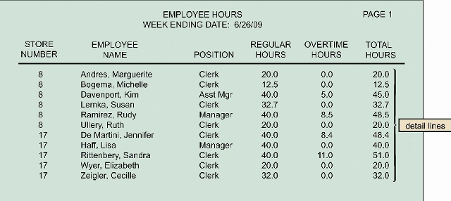

Slide 11
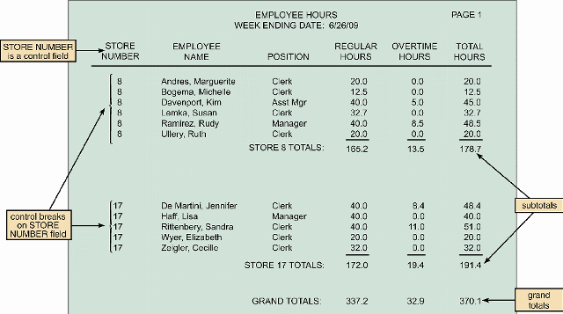

Slide 12
Printed and Screen Output
Types of Reports
  Exception reports: Display only the records that meet a specific condition or conditions
    Are useful when the user wants information only on records that might require action
    Report of overtime workers

Slide 13
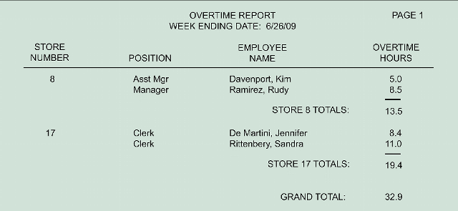

Slide 14
Printed and Screen Output
Types of Reports
  Summary reports
    Reports used by individuals at higher levels in the organization include less detail than reports used by lower-level employees
    Total regular and overtime hours worked by employees in each store.

Slide 15
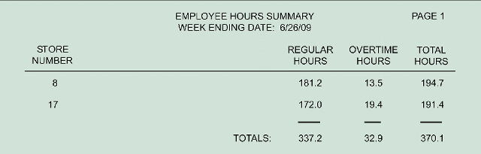

Slide 16
Printed and Screen Output
User Involvement in Report Design
  Printed reports are an important way of delivering information to users, so recipients should approve all report designs in advance
  To avoid problems submit each design for approval as you complete it, rather than waiting until you finish all report designs
  Mock-up report is a sample report or prototype
  Report analysis form must be filled after design is approved

Slide 17
Printed and Screen Output
Report Design Principles
  Printed reports must be attractive, professional, and easy to read
  Report headers and footers
  Page headers and footers
  Column heading alignment
  Column spacing

Slide 18
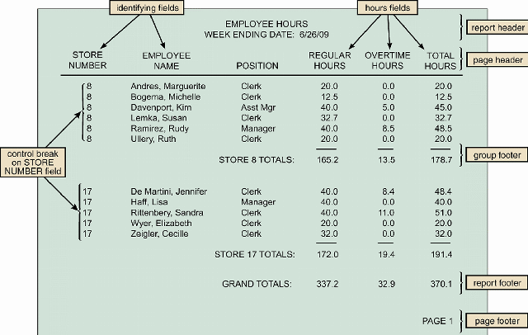

Slide 19
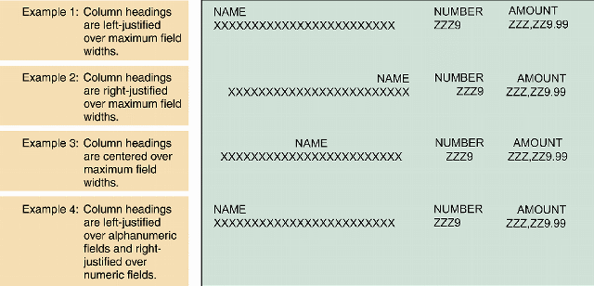

Slide 20
Printed and Screen Output
Report Design Principles
  Field order
    Fields should be displayed and grouped in a logical order
  Grouping detail lines
    It is meaningful to arrange detail lines in groups
    Group header
    Group footer
  Consistent design

Slide 21
Zeros may not be printed for no overtimes and overtimes would stand out
There is no need to display store numbers, group header could be used
There are many Clerks so they may not be printed

Slide 22
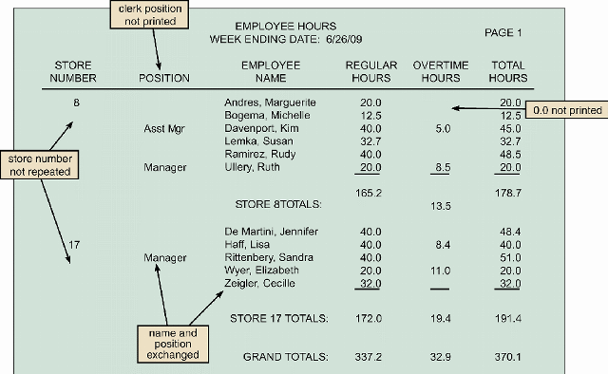
Improved version

Slide 23
Printed and Screen Output
Output Control and Security
  Output must be accurate, complete, current, and secure
  Output security protects privacy rights and shields the organization’s own data from theft or unauthorized access
  The IT department is responsible for output control and security measures

Slide 24


Slide 25
Printed and Screen Output
Output Control and Security
  Many companies have installed diskless workstations that limits the printing or copying of data except to certain network resources that can be monitored and controlled
  The number of removable media devices has expanded greatly along with a wide variety of physical interfaces such as USB
  A popular security solution is the use of a network based application, often called a port protector

Slide 26
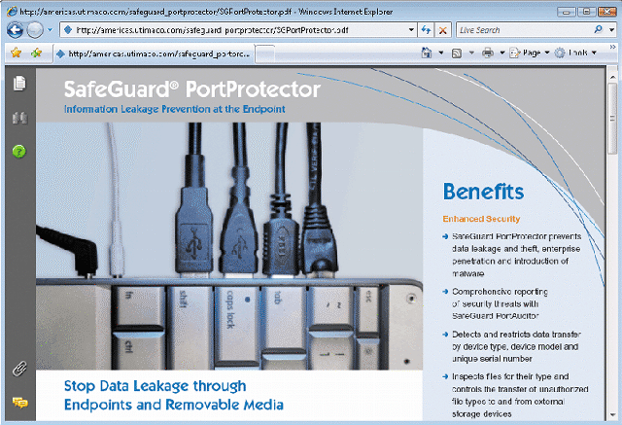

Slide 27
User Interface Design
Although output design involves a separate set of physical design issues, it is an integral part of a larger concept called a user interface (UI)
Consists of all the hardware, software, screens, menus, functions, and features that affect two-way communications between the user and the computer

Slide 28
User Interface Design
Evolution of the User Interface
  Process-control screens allow users to send commands to the system
  As information management evolved from centralized data processing to dynamic, enterprise-wide systems, the primary focus also shifted — from the IT department to the users themselves
  User-centered system: Requires an understanding of human-computer interaction and user-centered design principles

Slide 29
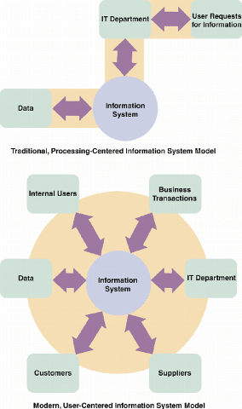

Slide 30
User Interface Design
Human-Computer Interaction
  Human-computer interaction (HCI) describes the relationship between computers and people who use them to perform business-related tasks
  Graphical user interface (GUI) uses icons, graphical objects and pointing devices
  Main objective is to create a user-friendly design that is easy to learn and use

Slide 31
User Interface Design
Human-Computer Interaction
  Interface will be based on the perspective of a user
  Dr. Clare-Marie Karat states that “in this new computer age, the customer is not only right, the customer has rights.”
  These rights are listed in next slide

Slide 32
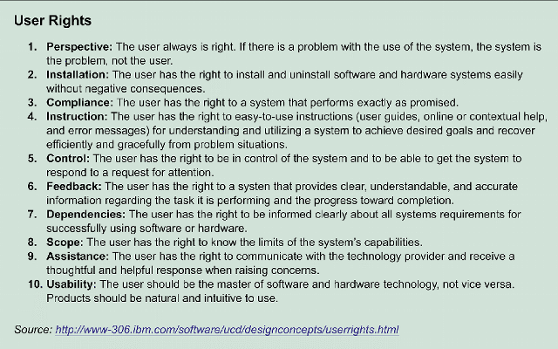

Slide 33
User Interface Design
Basic Principles of User-Centered Design
  Understand the underlying business functions. One way is to analyze DFDs
  Maximize graphical effectiveness since people learn better visually
  Profile the system’s users and understand their skill levels
  Think like a user and see system thorough a user’s eyes

Slide 34
User Interface Design
Basic Principles of User-Centered Design
  Use prototyping
    Storyboard: Sketches that show general screen layout
    Usability metrics: Record and measure user interaction by using software
  Design a comprehensive interface including all commands. Each screen should have reasonable number of commands
  Continue the feedback process
  Document the interface design

Slide 35
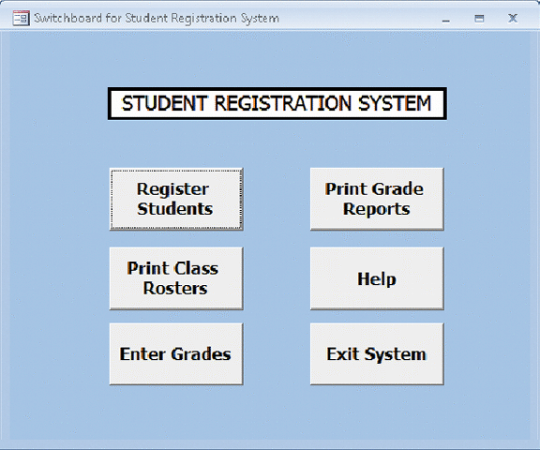

Slide 36
User Interface Design
Guidelines for User Interface Design
  Follow eight basic guidelines
    Focus on basic objectives
    Build an interface that is easy to learn and use
    Provide features that promote efficiency
    Make it easy for users to obtain help or correct errors
    Minimize input data problems
    Provide feedback to users
    Create an attractive layout and design
    Use familiar terms and images

Slide 37
User Interface Design
Guidelines for User Interface Design
  Good user interface design is based on a combination of:
    Ergonomics: Describes how people, work, learn, and interact with computers
    Aesthetics: Focus on how interface can be attractive and easy to use
    Interface technology: Provides the operational structure required to carry out the design objectives

Slide 38
User Interface Design
Guidelines for User Interface Design
  Focus on basic objectives
    Facilitate the system design objectives, rather than calling attention to the interface
    Create a design that is easy to learn and remember
    Design the interface to improve user efficiency and productivity
    Write commands, actions, and system responses that are consistent and predictable
    Minimize data entry problems
    Allow users to correct errors easily
    Create a logical and attractive layout

Slide 39
User Interface Design
Guidelines for User Interface Design
  Build an interface that is easy to learn and use
    Label clearly all controls, buttons, and icons
    Select only those images that a user can understand easily
    Show all commands in a list of menu items
    Make it easy to navigate or return to any level in the menu structure

Slide 40
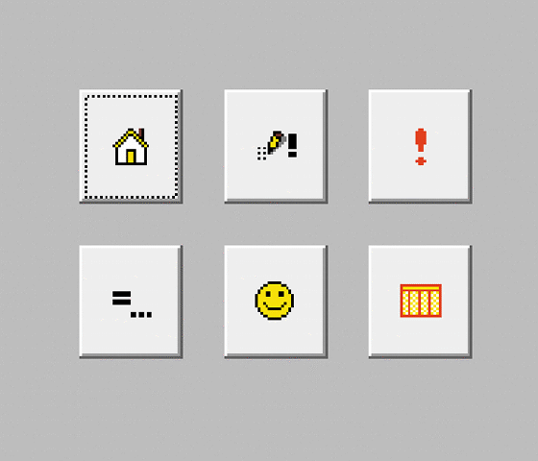
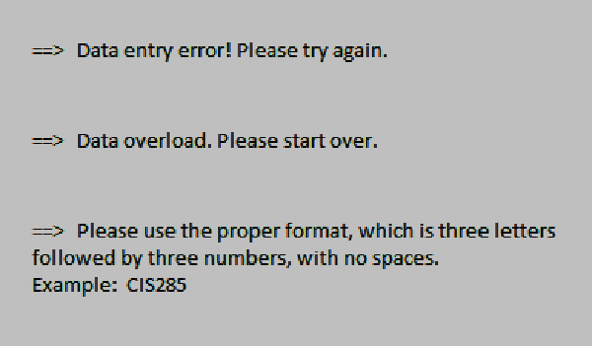

Slide 41
User Interface Design
Guidelines for User Interface Design
  Provide features that promote efficiency
    Organize tasks, commands, and functions in groups that resemble actual business operations
    Create alphabetical menu lists or place the selections used frequently at the top of the list
    Provide shortcuts so experienced users can avoid multiple menu levels
    Use default values if the majority of values in a field are the same
    Provide fast-find feature
    Use a natural language feature that allows user to type requests in normal Englis phrases

Slide 42
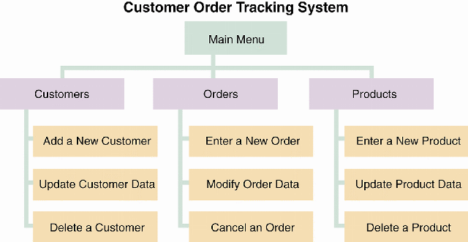

Slide 43
User Interface Design
Guidelines for User Interface Design
  Make it easy for users to obtain help or correct errors
    Ensure that Help is always available. Provide user-selected Help (when user requests) and context-sensitive Help (offer assistance for the task in progress). Provide a direct route for users to return to the point from where Help was requested
    Include contact information
    Require user confirmation before data deletion and provide method of recovering
    Provide Undo operation
    When error is made highlight the erroneous part

Slide 44
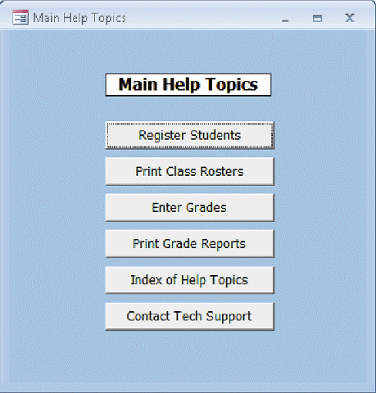
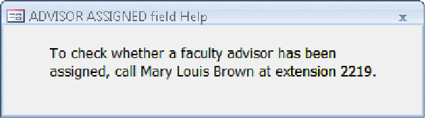
Dialog displayed when user requested help while entering data into the ADVISOR ASSIGNED field.

Slide 45
User Interface Design
Guidelines for User Interface Design
  Minimize input data problems
    Provide data validation checks
    Display event-driven messages and reminders (ask if saved before entering)
    Establish a list of predefined values that users can click to select
    Build in rules that enforce data integrity
    Use input masks as templates to make data entrance easier

Slide 46
User Interface Design
Guidelines for User Interface Design
  Provide feedback to users
    Display messages at a logical place on the screen and be consistent
    Alert users to lengthy processing times or delays
    Allow messages to remain on the screen long enough for users to read them, maybe wait for an action before removing the message
    Let the user know whether the task or operation was successful or not (update completed)
    Provide a text explanation for icons or images used as command buttons
    Use understandable messages

Slide 47
User Interface Design
Guidelines for User Interface Design
  Create an attractive layout and design
    Use appropriate colors to highlight different areas of the screen
    Use special effects sparingly
    Use hyperlinks that allow users to jump to related topics
    Group related objects and information
    Keep screen displays uncluttered
    Be consistent for terminology and locations

Slide 48
User Interface Design
Guidelines for User Interface Design
  Use familiar terms and images
    Remember that users are accustomed to a pattern of red=stop, yellow=caution, and green=go
    Provide a keystroke alternative for each menu command
    Use familiar commands if possible such as Cut, Copy, Paste
    Provide a Windows look and feel in your interface design if users are familiar with Windows-based applications
    Avoid complex terms

Slide 49
User Interface Design
User Interface Controls
  Menu bar and toolbar
  Command button
  Dialog box
  Text box, list box, drop-down list box
  Toggle button, option button/radio button, check box
  Calendar control
  Switchboard

Slide 50
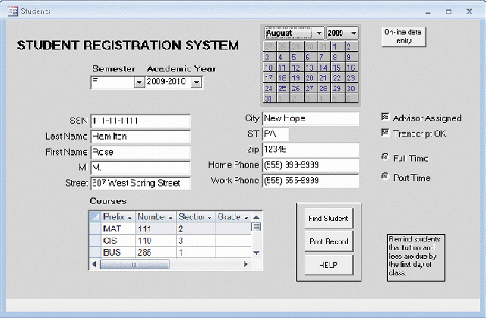

Slide 51
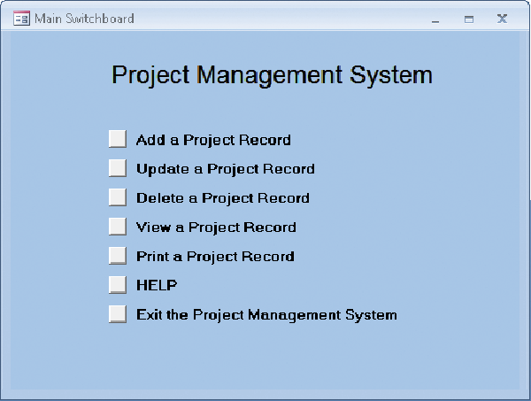

Slide 52
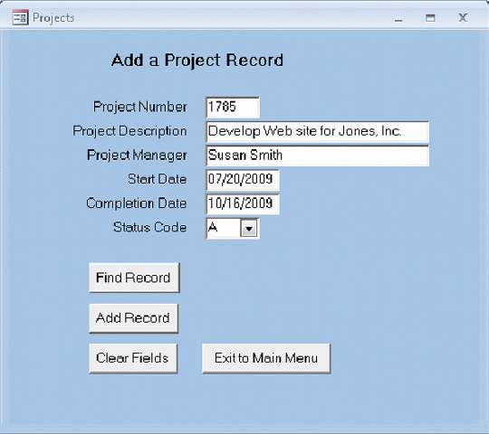
Data entry screen

Slide 53
Input Design
Input technology has changed dramatically in recent years
  Biological feedback devices (fingerprint)
  Brain-computer interface (virtual reality)
  Electronic whiteboard
  Magnetic ink character recognition (read characters printed on checks)
  Motion sensors
  Radio frequency identification

Slide 54
Input Design
The quality of the output is only as good as the quality of the input
  Garbage in, garbage out (GIGO): best time to avoid problems is when data is entered
  Data capture: Uses automated or manually operated device to identify source data and convert into digital form (scanners)
  Data entry: process of entering data manually using keystrokes or mouse clicks

Slide 55
Input Design
Input and Data Entry Methods
  Batch input: Data entry usually is performed on a specific time schedule.
  Online input: Immediate validation and availability of data
  Tradeoffs:
    Unless source data automation is used online data entry is slower and more expensive than batch since it is performed at the time of transaction and often done when computer demand is highest

Slide 56
Input Design
Input Volume
  Guidelines will help reduce input volume
    Input necessary data only (if you will not use then do not ask for the sale clerk’s name for orders)
    Do not input data that the user can retrieve from system files or calculate from other data
    Do not input constant data, such as today’s date
    Use codes to shorten data entry times

Slide 57
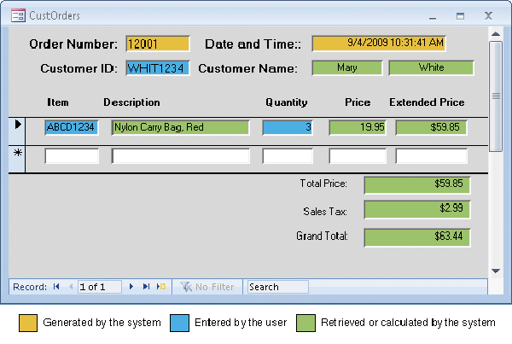

Slide 58
Input Design
Designing Data Entry Screens
  Most effective method of online data entry is form filling
  Guidelines will help you design data entry screens
    Restrict user access to screen locations where data is entered
    Provide a descriptive caption for every field, and show the user where to enter the data and the required or maximum field size

Slide 59
Input Design
Designing Data Entry Screens
  Guidelines will help you design data entry screens
    Display a sample format if a user must enter values in a field in a specific format – separator (MM/DD/YYYY)
    Require an ending keystroke for every field
    Do not require users to type leading zeroes for numeric fields
    Do not require users to type trailing zeroes for numbers that include decimals

Slide 60
Input Design
Designing Data Entry Screens
  Guidelines will help you design data entry screens
    Display default values so operators can press the ENTER key to accept the suggested value
    Use a default value when a field value will be constant for successive records or throughout the data entry session (date)
    Display a list of acceptable values for fields, and provide meaningful error messages

Slide 61
Input Design
Designing Data Entry Screens
  Guidelines will help you design data entry screens
    Provide a way to leave the data entry screen at any time without entering the current record (cancel)
    Provide users with an opportunity to confirm the accuracy of input data before entering it (add this record? (Y/N)
    Provide a means for users to move among fields on the form (tab, arrows)

Slide 62
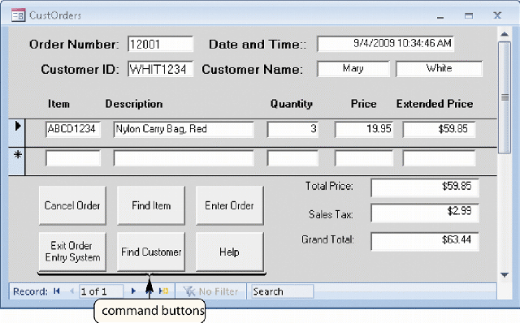

Slide 63
Input Design
Designing Data Entry Screens
  Guidelines will help you design data entry screens
    Design the screen form layout to match the layout of the source document
    Allow users to add, change, delete, and view records
    Provide a method to allow users to search for specific information (find customer)

Slide 64
Input Design
Input Errors
  Reducing the number of input errors improves data quality
  A data validation check improves input quality by testing the data and rejecting any entry that fails to meet specified conditions

Slide 65
Input Design
Input Errors
  At least eight types of data validation checks
    Sequence check: If work orders should be entered in numerical sequence then out of sequence entrance should cause error
    Existence check: Used for mandatory items (SSN)
    Data type check (Numeric field can not have A)
    Range check – limit check (daily work hours should be between 0 and 24)

Slide 66
Input Design
Input Errors
  At least eight types of data validation checks
    Reasonableness check: Data may pass limit check but may not be reasonable (24 hours of work)
    Validity check – referential integrity (Customer number that does not match master file)
    Combination check (input discount only for purchases of 100 or more)
    Batch controls are totals used to verify batch input, also called hash totals (not meaningful only used for combination)

Slide 67
Input Design
Source Document: Form used to request and collect data, trigger an input action and provide a record of the original transaction
  Form layout: Insufficient space, confusing instructions, poor organization

Slide 68
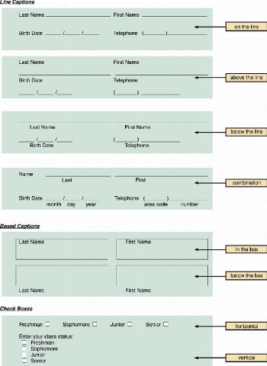

Slide 69
Input Design
Source Documents
  Heading zone: Company name, logo
  Control zone: ID info, date, codes
  Instruction zone: Instructions for completion
  Body zone: Form fields and captions
  Totals zone: Zone for totals
  Authorization zone: Required signatures

Slide 70
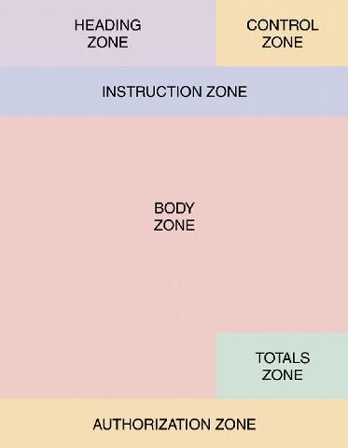

Slide 71
Input Design
Source Documents
  Information should flow on a form from left to right and top to bottom to match the way users read documents naturally
  A major challenge of Web-based form design is that most people read and interact differently with on-screen information compared to paper forms

Slide 72
Input Design
Source Documents
  Dr. Jakob Nielson believes that users scan a page, picking out individual words and sentences
  As a result, Web designers must use scannable text to capture and hold a user’s attention

Slide 73
Input Design
Input Control (correct, complete and secure)
  Every piece of information should be traceable back to the input data, an audit trail must be provided (creation and changes on word documents)
  Data security policies and procedures must be described (levels of access, encryption)
  Records retention policy to keep data in a safe location and meet all legal requirements and business needs

